Slide 1

Introduction Project Team 2:
Kayla Jehnzen
Zach Pedersen
Tristan Perry
Justen Hix
Why did we select these counties and where are they?
Climate Change Floods North Carolina’s Housing Market
As sea level and extreme weather risks rise, larger down payments, inequities in insurance, and heirs’ properties could leave coastal residents drowning in debt and devalued homes.
Of the five coastal communities most frequently hit by hurricanes between 1960 and 2008, three were North Carolina counties: Carteret, Dare, and Hyde. Over the last decade, Hurricanes Matthew, Irene, Florence, and Dorian have all struck one or more of them.

Slide 2
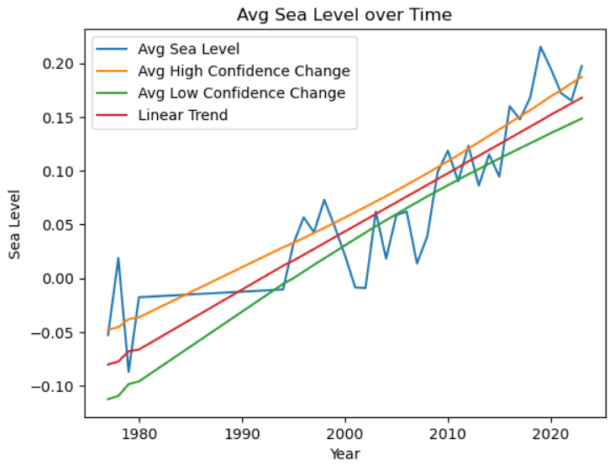
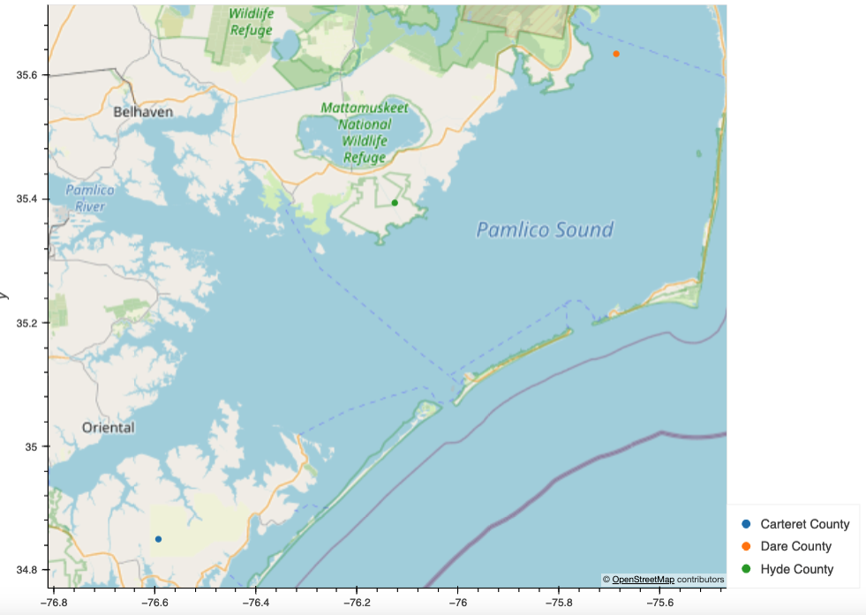
#https://tidesandcurrents.noaa.gov/sltrends/sltrends_station.shtml?id=8652587
#Data collected by NOAA Station 8652587, Oregon Inlet Marina, North Carolina.
#Monthly mean sea levels with the average seasonal cycle removed.
#The values are in meters relative to the most recent Mean Sea Level datum established by CO-OPS.
#Column values are the Year; Month; Monthly Mean; Relative Sea Level Trend Line; Higher 95% Confidence Interval; and Lower 95% Confidence Interval.

Slide 3
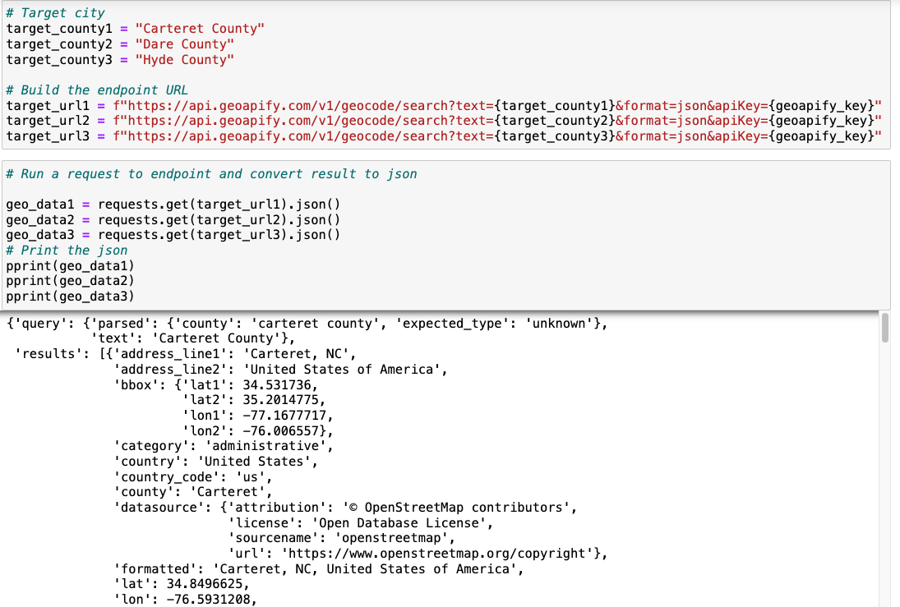

Slide 4




Data Sources and Technology Used
Zillow
NCEI/NOAA
US Census
NC Office of State Budget and Management
Dare County, NC Website/Hurricane History
Carteret County, NC Website/Hurricane History
Hyde County, NC Website/Hurricane History
Data Cleaning Process
Downloading CSV, Pandas Dataframe, Matplotlib Visualization
API Calls GeoViews

Slide 5

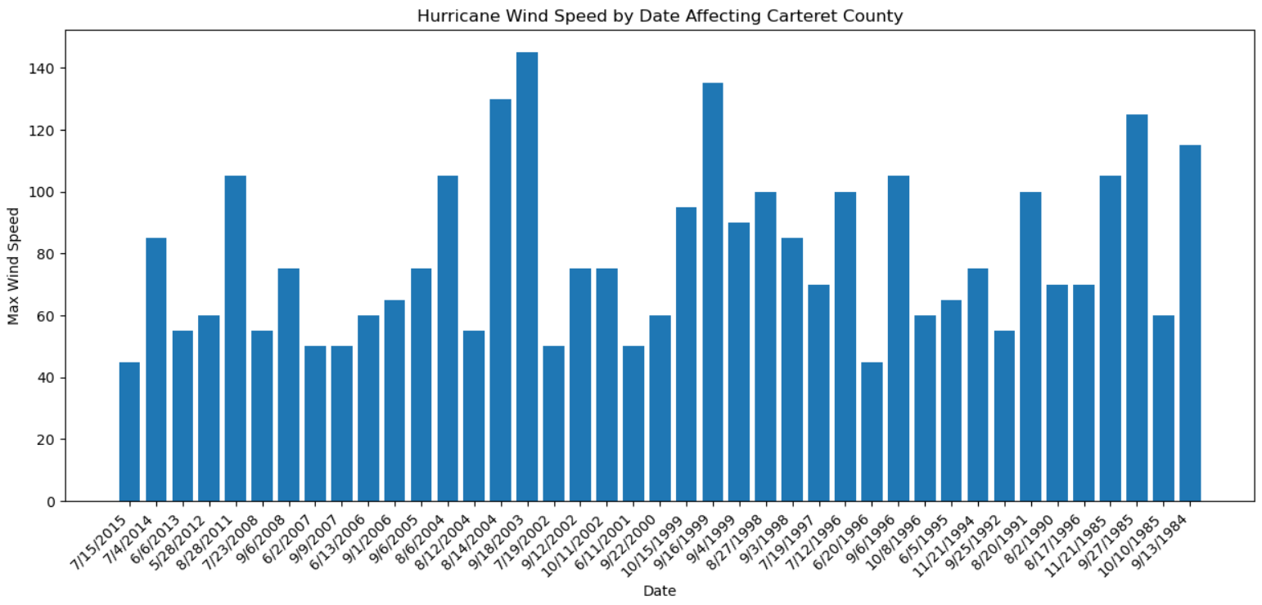
Wind Speed Trends: Carteret County
https://www.weather.gov/mhx/Isabel#:~:text=Hurricane%20Isabel%20left%20her%20permanent,by%20falling%20trees%20or%20limbs.

Slide 6
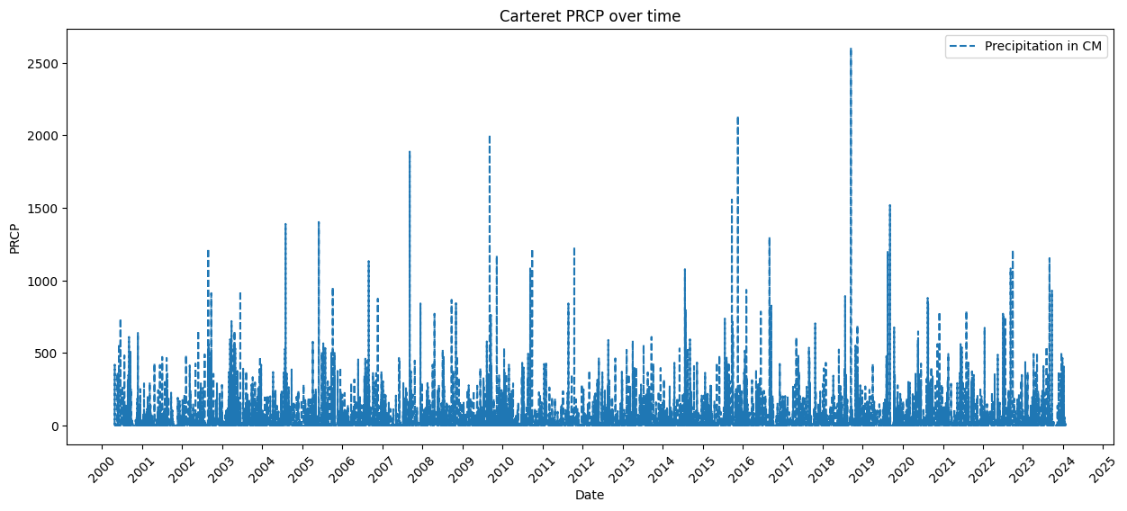
Precipitation Trends: Carteret County
https://www.weather.gov/ilm/HurricaneFlorence

Slide 7
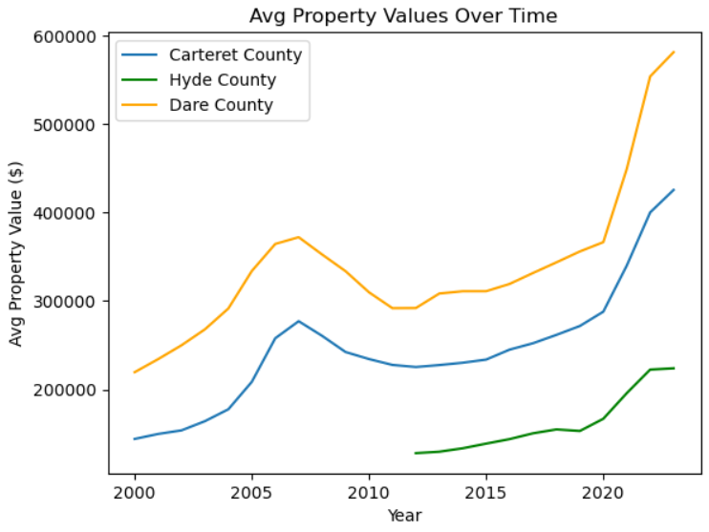
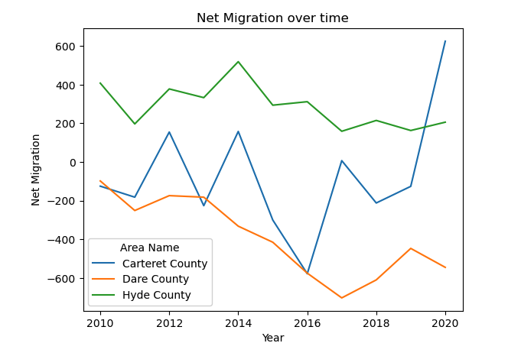
Property Values and Migration: Carteret County

Slide 8

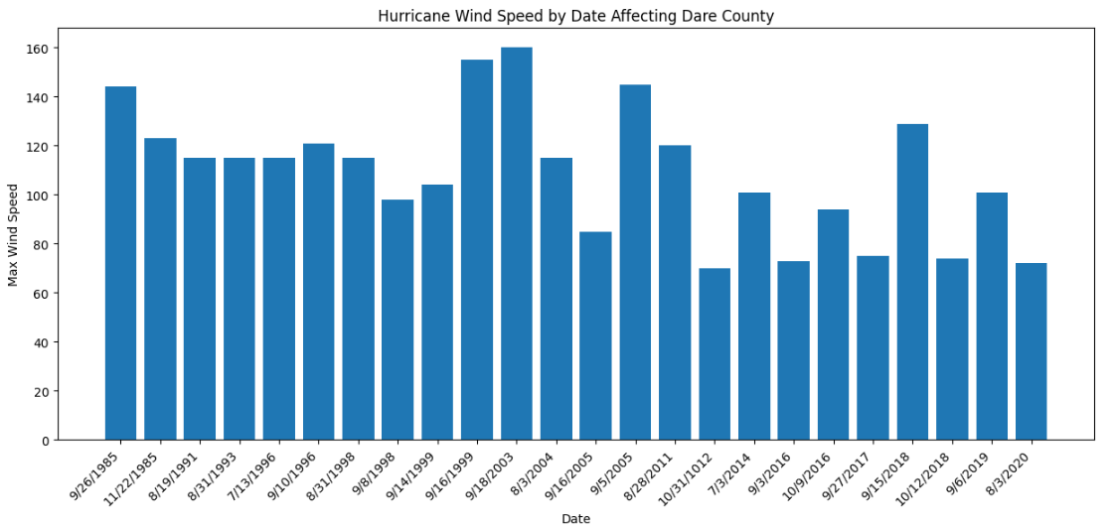
Wind Speed Trends: Dare County

Slide 9
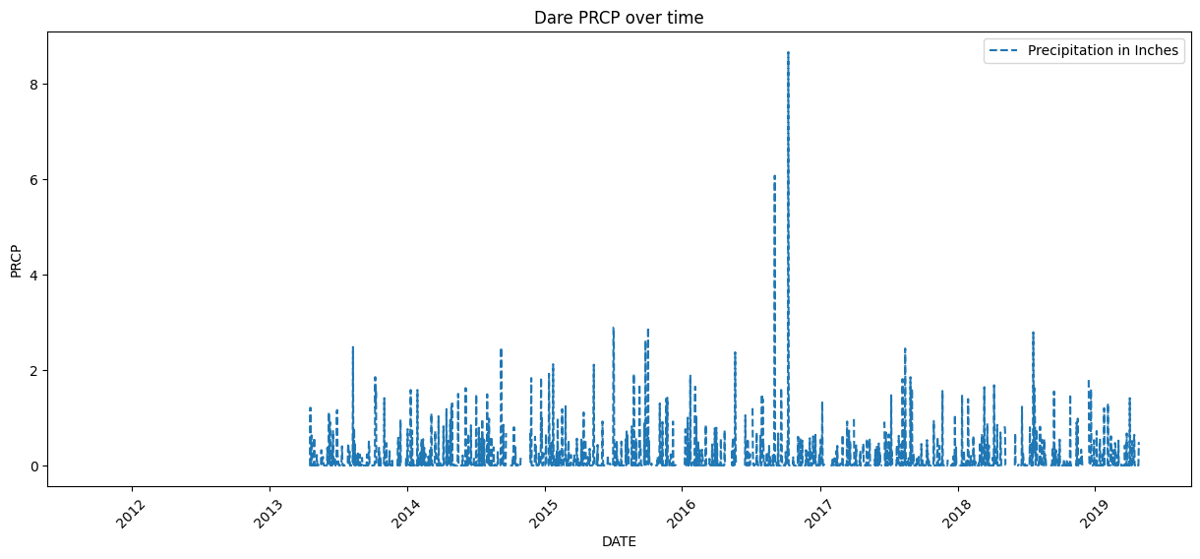
Precipitation trends: Dare County

Slide 10
Property Values and Migration: Dare County

Slide 11

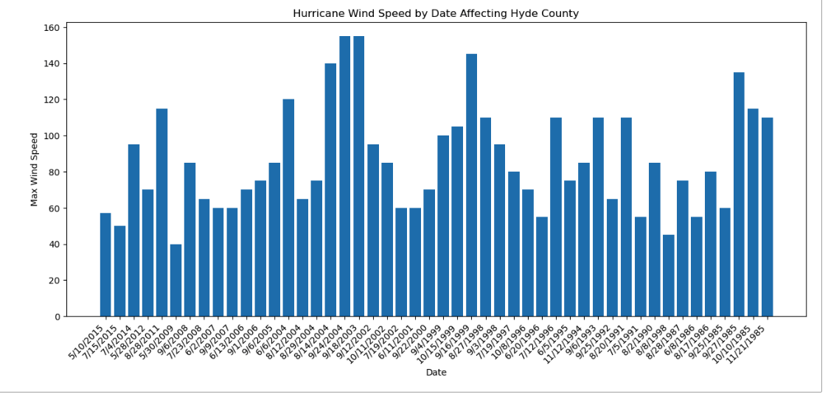
Wind Speed Trends: Hyde County

Slide 12
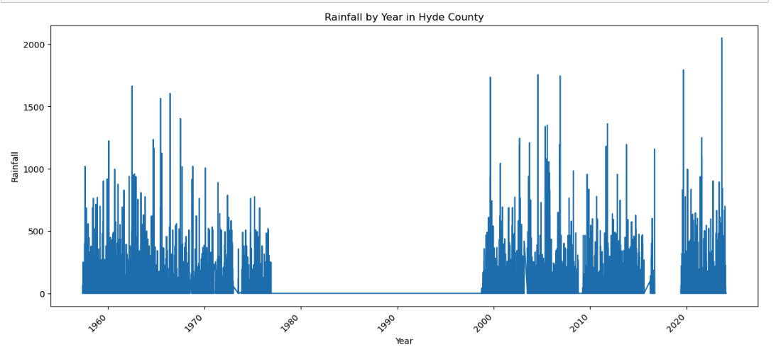
Precipitation trends: Hyde County

Slide 13
Property Values and Migration: Hyde County
Notes:
Could explain that due to low total population of Hyde county, comparisons could be inconclusive

Slide 14
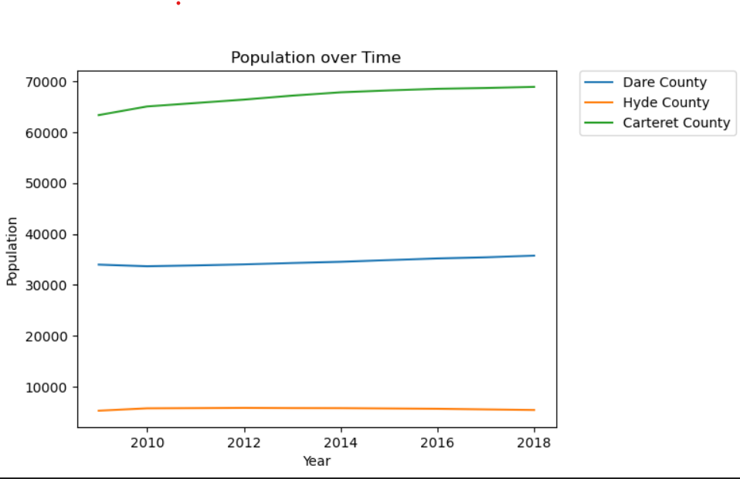
What did we learn?

